Slide 1
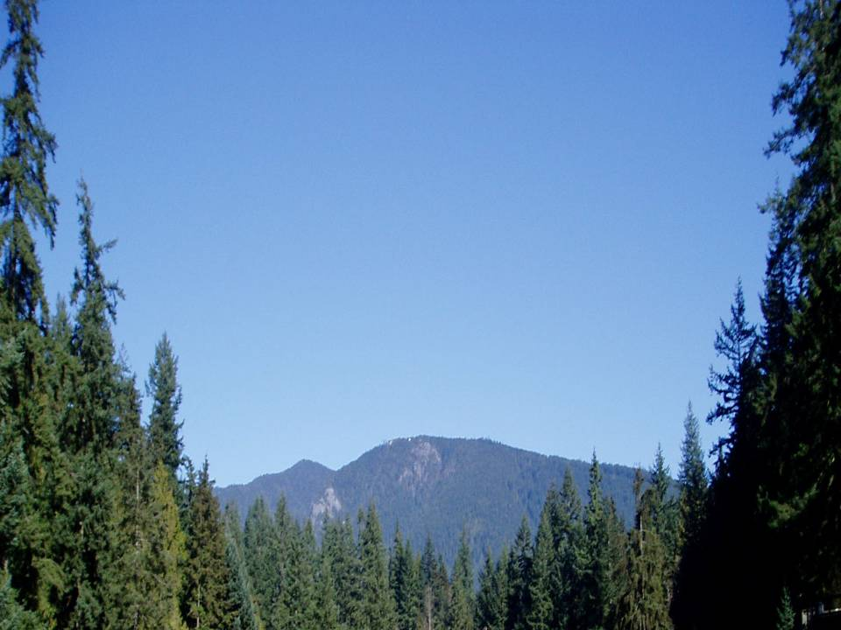


Mapping of stress on native tree species across western U.S.A. & Canada: interpretation of climatically-induced changes using a physiologically-based approach
Amanda Mathys²
Richard Waring¹
Nicholas Coops²
¹ Oregon State University
² University of British Columbia

Slide 2
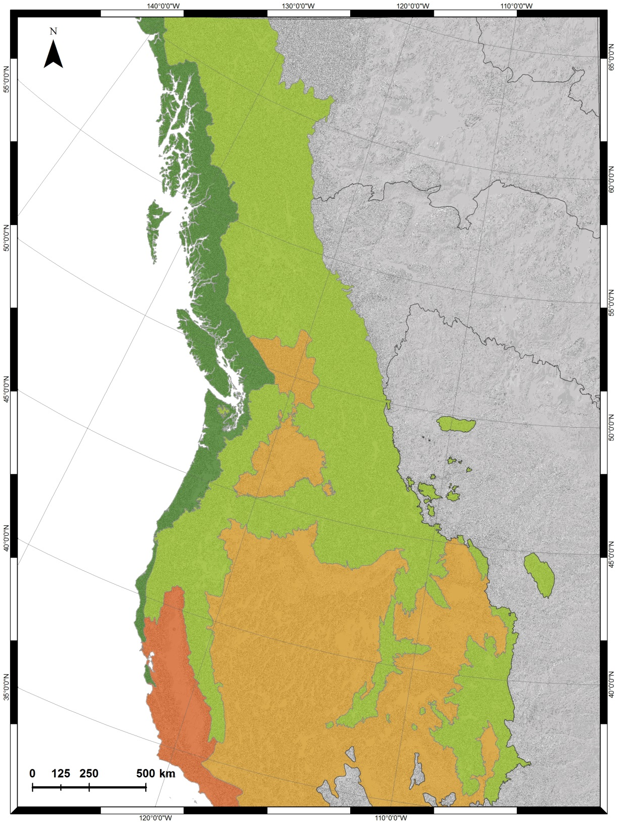
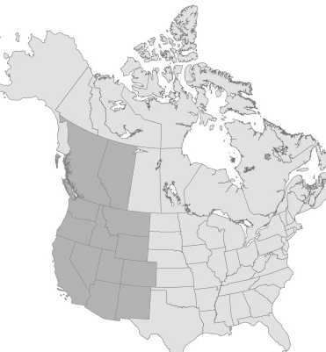
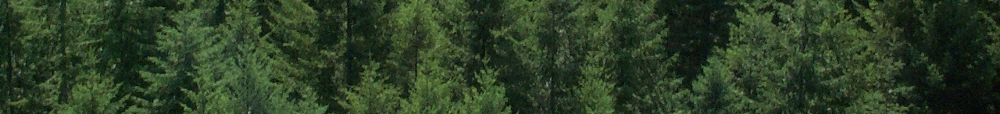
Ecoregions
Northwest Forested Mountains
Marine West Coast Forest
North American Deserts
Mediterranean California

Slide 3
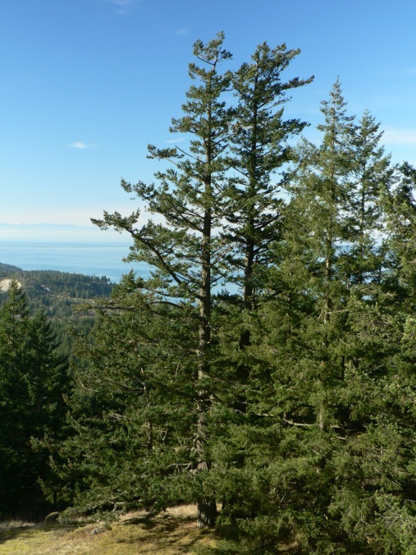
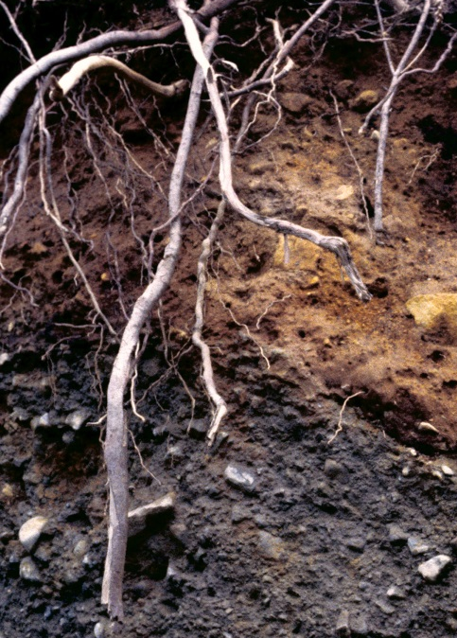
Soil maps
Soil important component of species growth
Mapped spatial soil properties at 1 km (Coops et al. 2012)
Soil maps as input to process-based forest growth model to predict species distributions (Mathys et al. 2014)
Notes:
Limited regional soil data available across political boundaries

Slide 4
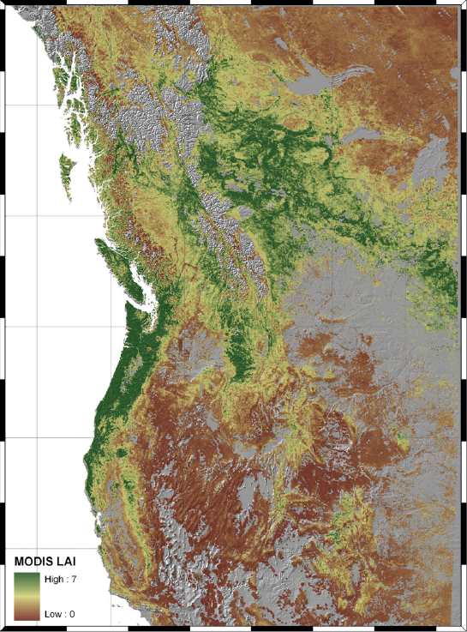
(Coops et al. 2012)

Slide 5
75% of tree species affected by ASWC (Mathys et al. 2014)
30% of species extremely sensitive and 45% somewhat sensitive

Slide 6
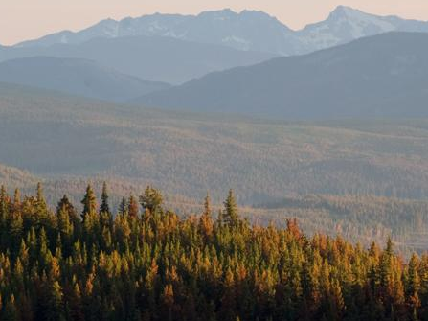
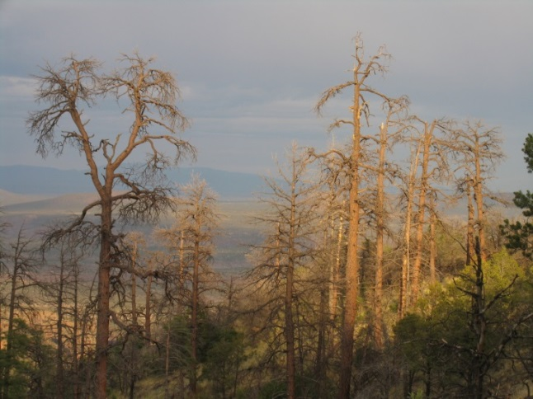
Species vulnerability
Climate change is impacting forest growth and productivity
Changes in disturbances with climate leading to shifts in species distributions
Species vulnerabilities modelled using >70% threshold during 2000-2009 compared to historic range 1950-75

Slide 7
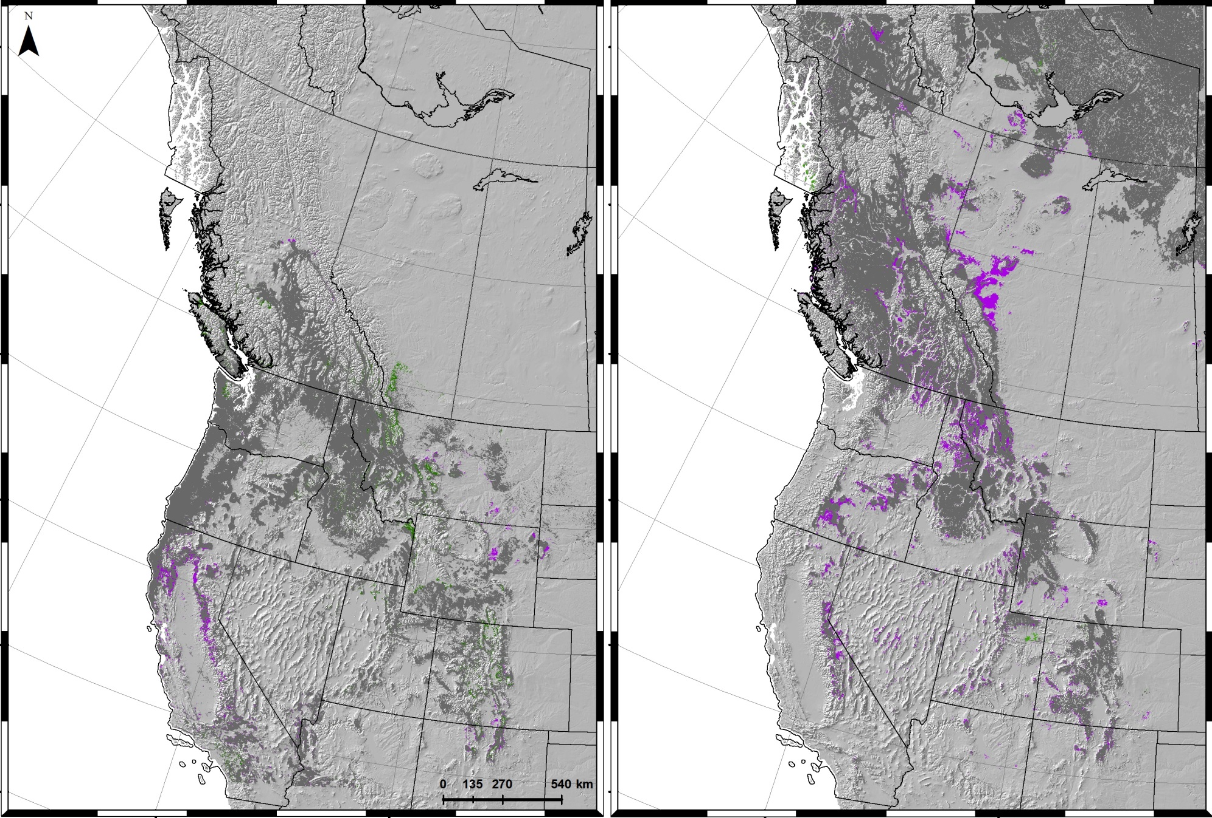
Douglas-fir
Lodgepole pine
Range expansion
Historic range
Stressed in current range

Slide 8
Model validation
A need for field monitoring of current tree species distributions and their vulnerability to climate shifts:
      Ground observations with volunteers
      Use existing regeneration data

Slide 9
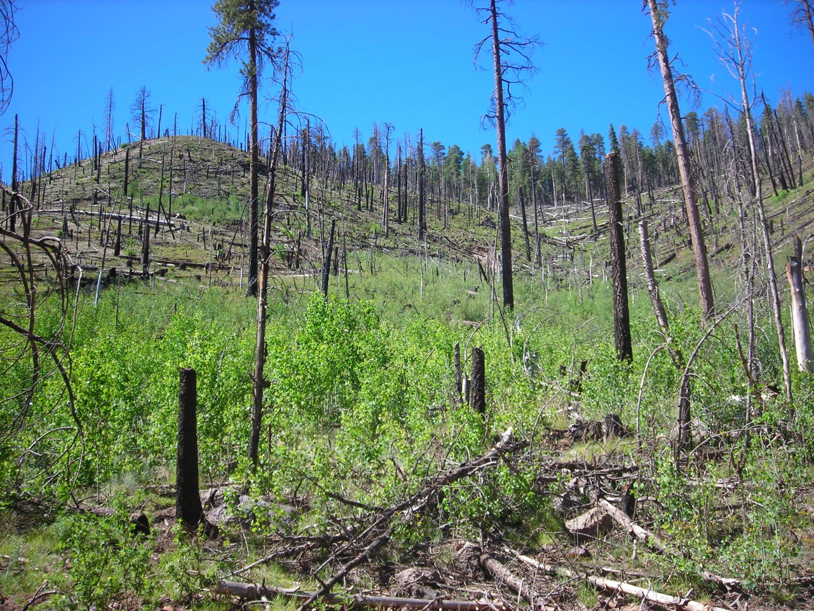
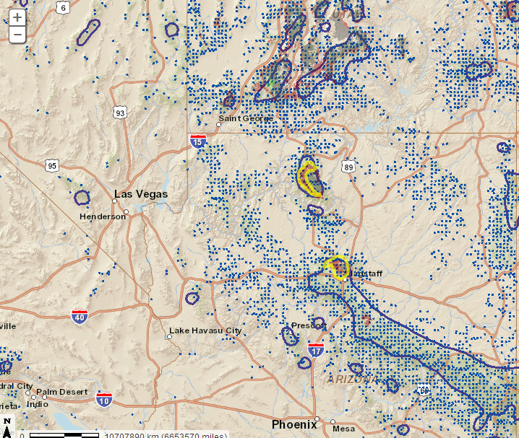
Aspen decline in Arizona
Wildfire near Flagstaff killed the Aspen overstory
Drought in 2002-2003
Notes:
northern Ariz for aspen In places were aspen was disturbed, regen came up, although some were browsed by deer (Thomas Kolb)

Slide 10
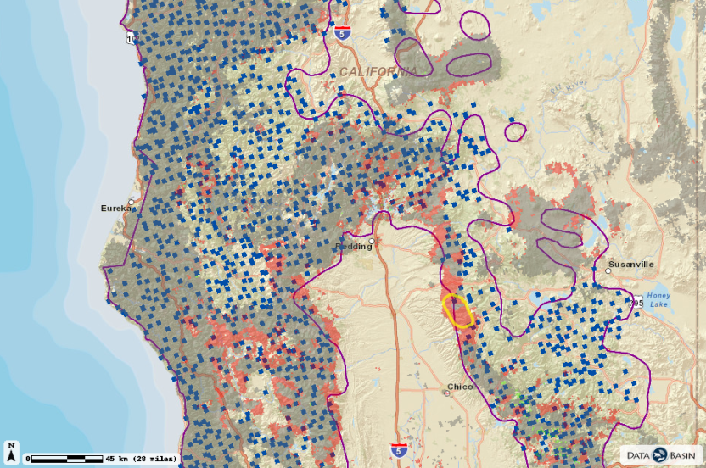
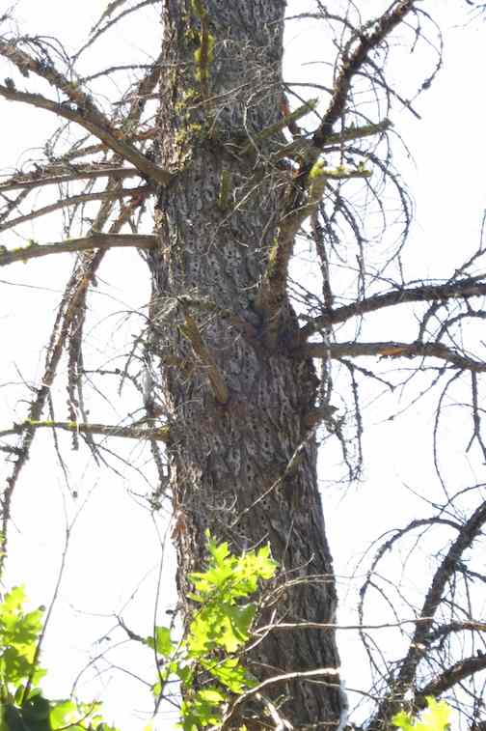
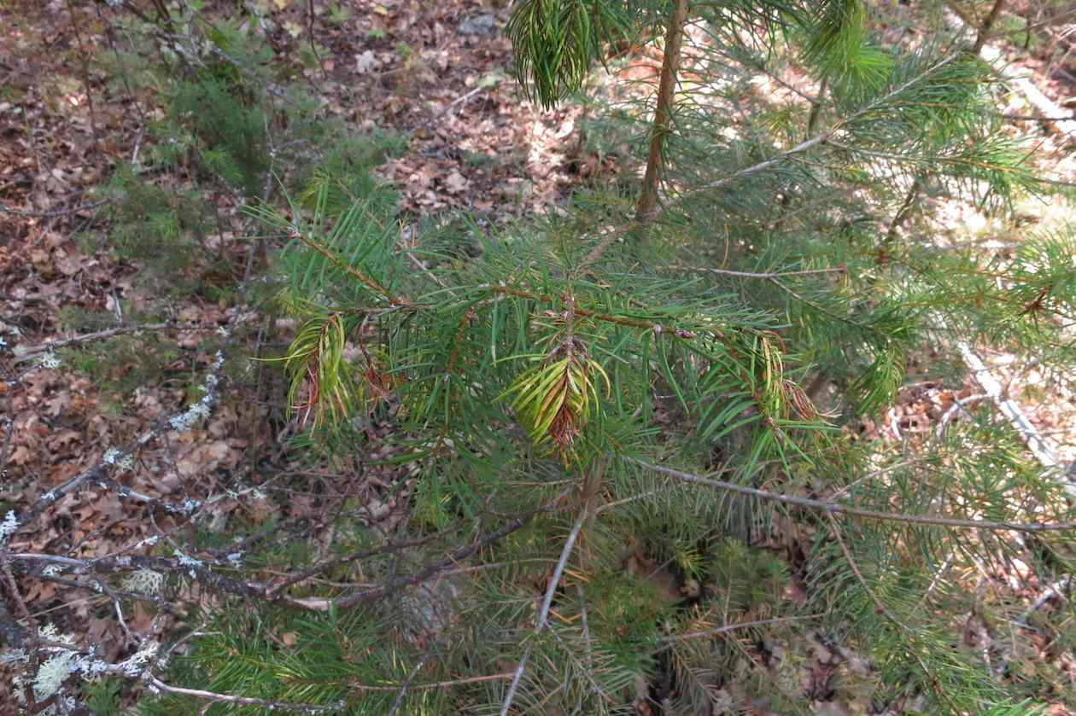
Drought effects on Douglas-fir in California
Bark beetle attack on Douglas-fir
Notes:
Very limited regen, the new foliage on the wilted Douglas-fir seedling is classic drought response
In CA, the extent of drought brings on insect, fire, and root rot…eventually reducing leaf area.

Slide 11
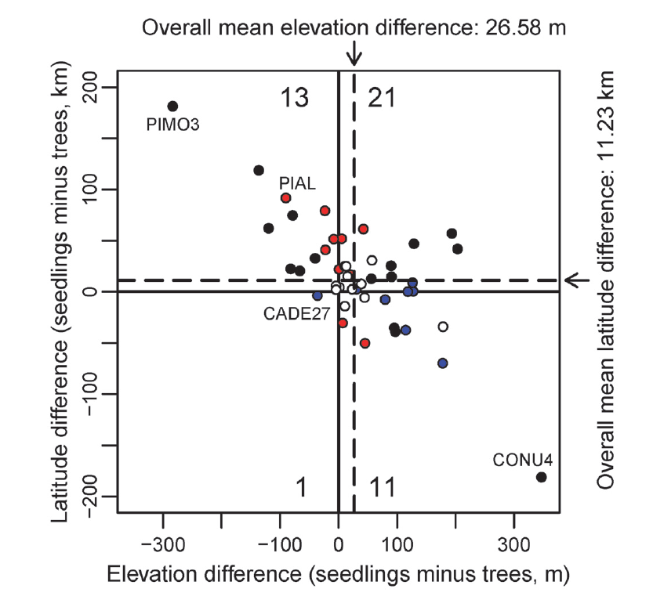
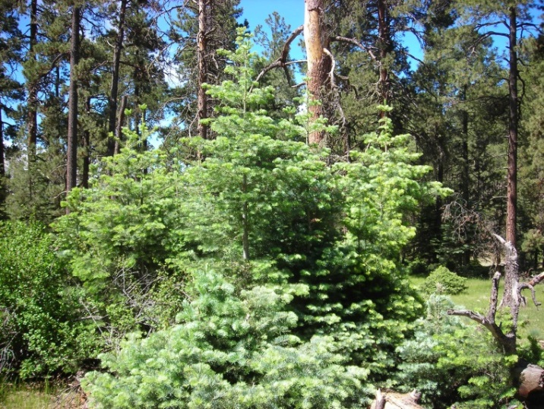
Species establishment
FIA seedling data available in the US can be compared with occurrence of mature trees
(Monleon and Lintz, 2015)

Slide 12

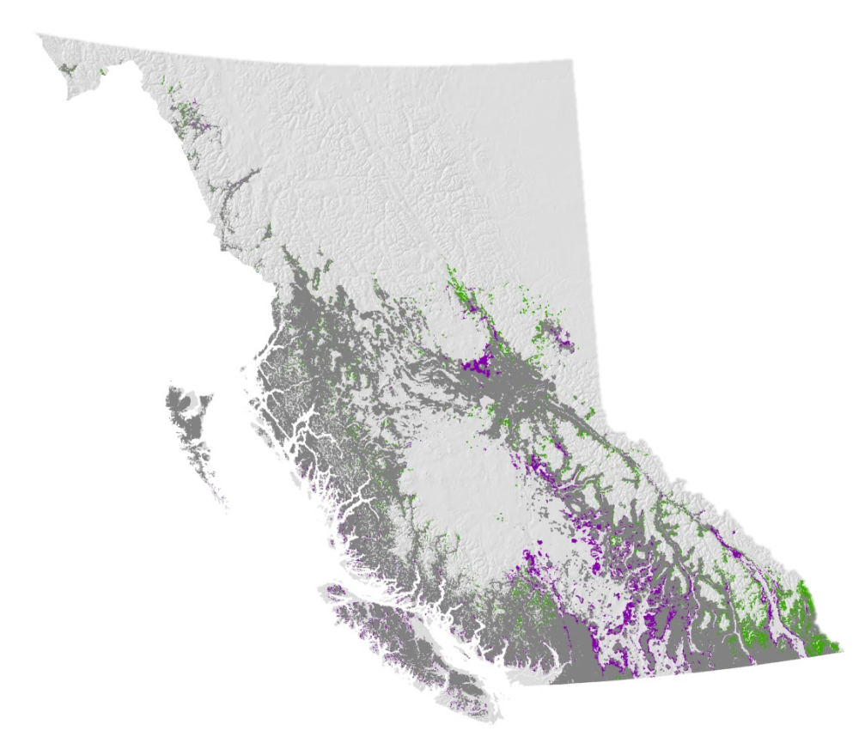
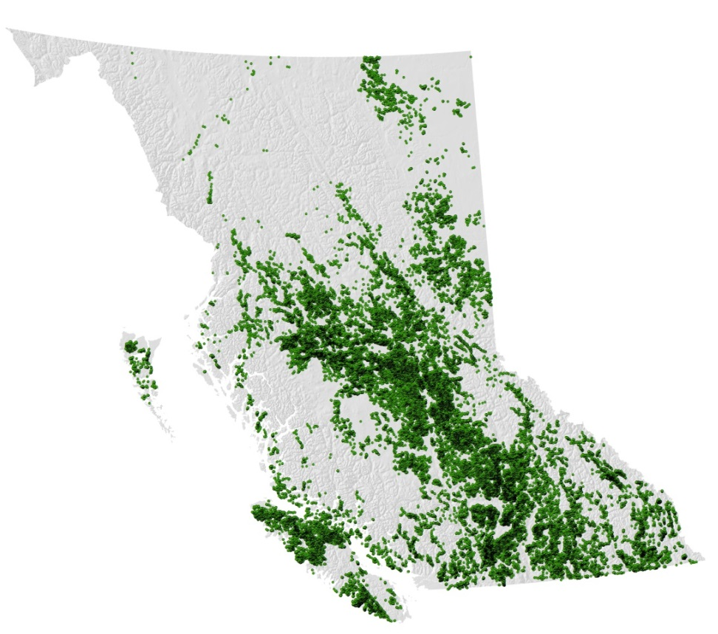
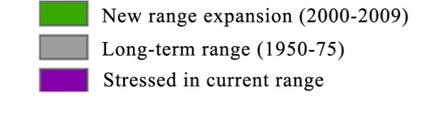
Reporting Silviculture Updates and Land Status Tracking System (RESULTS)

Slide 13
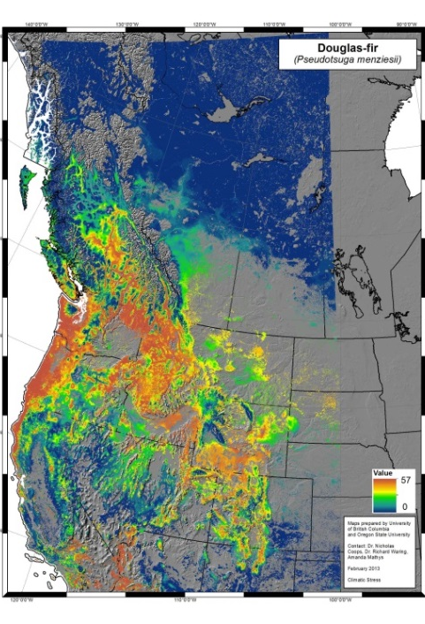
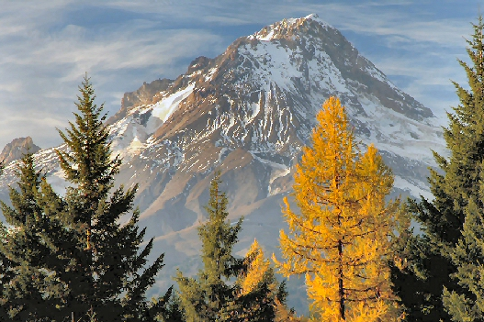
Future species distributions
Climate change response: adaptation and migration
Predict tree species range expansion and contraction to end of 21st century
Use annual climate data to improve projections

Slide 14


Data access
All species models available on Data Basin: http://databasin.org
3-PG model website: http://3pg.forestry.ubc.ca/

Slide 15
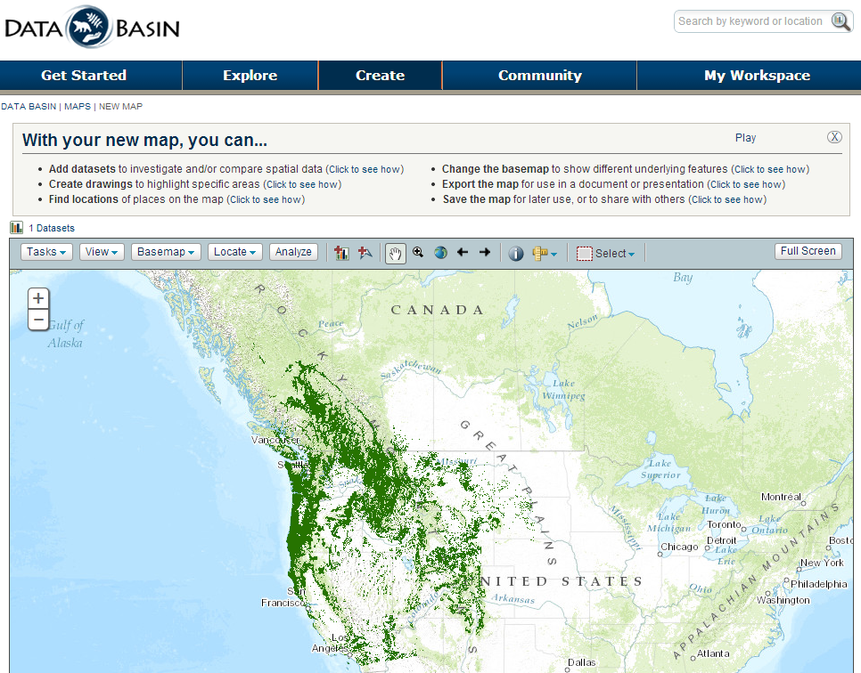
Tree species distributions and soil maps accessible on Data Basin
http://databasin.org

Slide 16
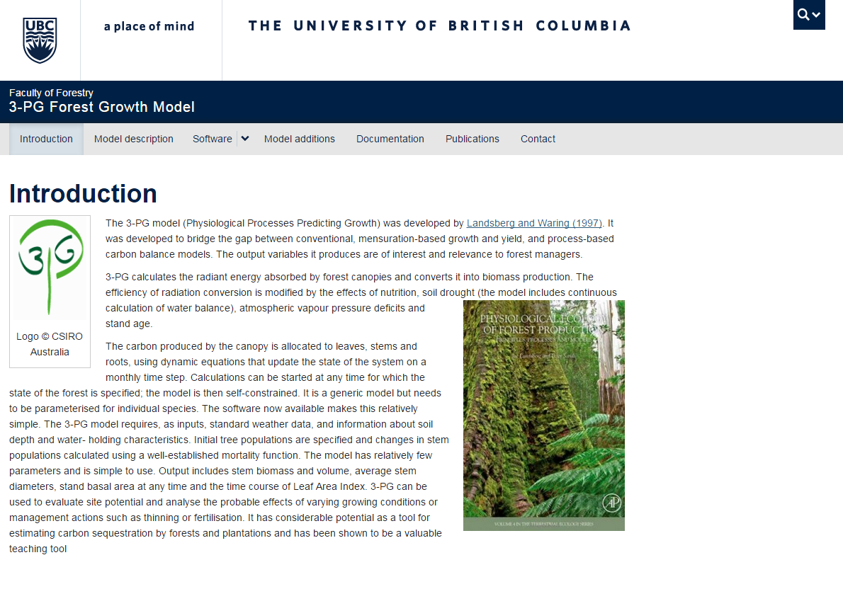
3-PG website
http://3pg.forestry.ubc.ca/

Slide 17
Other projects:
Projecting migration directions of tree species
Mapping fire occurrences in western North America
Predicting Dothistroma needle-cast disease outbreaks in British Columbia
Notes:
Migration paper submitted to Landscape Ecology
Takes into account different land cover types and reproductive rates that can pose limits on species migrations > provides more realistic maps of direction species may migrate towards
constrained by max rates of about 2 km/year
Dothistroma: Susceptibiliy of lodgepole pine to dothistroma outbreak

Slide 18



Thank you!

Slide 19
References
Coops, N.C., Waring., Hilker, T., 2012. Prediction of soil properties using a process-based forest growth model to match satellite-derived estimates of leaf area index. Remote Sensing of Environment 126, 160-173.
Mathys, A., Coops, N.C., Waring, R.H., 2014. Soil water availability effects on the distribution of 20 tree species in western North America. Forest Ecology and Management 313, 144–152.
Monleon, V.J., Lintz, H.E., 2015. Evidence of Tree Species’ Range Shifts in a Complex Landscape. PLoS ONE 10, e0118069. doi:10.1371/journal.pone.0118069

Slide 20
